Slide 1



AWS Foundation
Amazon FSx, AWS Organizations, & Global Accelerator
Notes:
Welcome back to the forth module of data science.

Slide 2
Agenda
Global Accelerator Components
1
Introduction to Amazon FSx
7
Amazon FSx for
Windows File Server
Introduction to AWS Organizations
2
8
3
Amazon FSx for Lustre
9
Starting off with Organizations
Hands-on: Amazon FSx for Windows File Server
4
10
Elastic Network Interface
Hands-on: Amazon FSx for Lustre
5
11
11
Elastic Network Adapter
Introduction to Global Accelerator
6
12
Elastic Fabric Adapter

Slide 3
Introduction to Amazon FSx

Slide 4
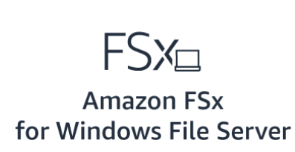

Introduction to Amazon FSx
Using FSx, we can launch and run high-performing file systems with just a few clicks while avoiding tasks such as provisioning hardware, configuring software, or taking backups
AWS FSx provides two file systems to choose from:

Slide 5






Introduction to Amazon FSx
Why should we use AWS FSx?
Simple and fully managed
Fast delivery
Highly available and durable
Pay only for the used resources
Secure and complaint
Easy integration with other
AWS services

Slide 6
Amazon FSx for
Windows File Server

Slide 7
Amazon FSx for Windows File Server
For Windows File Server
A native Microsoft Windows file system so that we can move our windows-based apps to this shared storage in AWS. Built on a Windows server, it has great compatibility with Microsoft products
We get full support for the SMB protocol, Windows NTFS, and Microsoft Active Directory (AD) integration. Also, FSx uses SSD for fast performance

Slide 8
Amazon FSx for Windows File Server
Features of AWS FSx for Windows File Server
01
Native Windows compatible: FSx supports all Windows versions starting from Windows 7
02
Broadly accessible: It can connect our file system to Amazon EC2, Workspaces, and even VMware cloud on AWS
03
Fully managed: It is very simple to launch and use the shared file storage for our Windows applications that run on AWS
04
Built on SSD storage: It is designed for fast and consistent delivery and provides up to 2 GB/s of throughput per file system

Slide 9



Amazon FSx for Windows File Server
Use Cases
Lift-and-shift Application Workloads
Software Development Environments
Windows-based applications and workloads, such as ERP, CRM, and custom-built .NET applications, require shared file storage
Development environments include source code and build repositories residing on shared file storage that support many developers working on the same projects

Slide 10
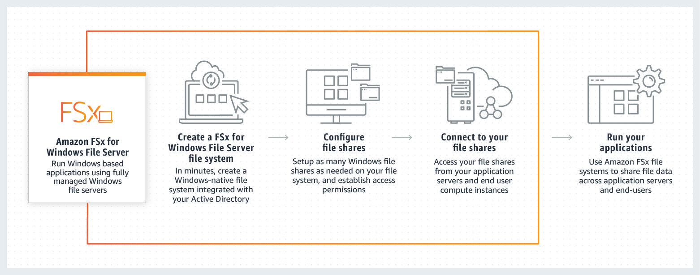
Amazon FSx for Windows File Server
How does FSx for Windows File Server work?
Amazon FSx for Windows File Server
Create an FSx for Windows File Server File System
Configure File Shares
Connect to the File Shares
Run the Applications
Run Windows-based applications using fully managed Windows file servers
Set up as many Windows files shares as needed on our file system and establish access permissions
Access our file shares from our application servers and end-user compute instances
Use Amazon FSx file systems to share file data across application servers and end-users
In minutes, create a Windows-native file system integrated with the Active Directory

Slide 11
Amazon FSx for Windows File Server
Supported Clients, Access methods and Environments
Clients
Access methods
Environments
Amazon EC2 instances
Amazon WorkSpaces instances
Amazon AppStream 2.0 instances
VMware Cloud on AWS
Using DNS names
Distributed File System Namespaces
From an on-premises environment
From an AWS account, another VPC or region

Slide 12

Amazon FSx for Windows File Server
Failover Process
The Multi-AZ file system will start failover automatically if any of the below conditions prevail:
An availability zone outage
The preferred file server is unavailable
The preferred file server undergoes planned maintenance

Slide 13
Amazon FSx for Windows File Server
Failover Process
What exactly happens when a failover process starts?
When failing over from a file system server to another, the new file system will start serving all read and write requests
Once all resources are available in the required subnet, FSx automatically goes back to the preferred file server
For a failover to complete, it takes around 30 seconds from when it detected a failure

Slide 14
Amazon FSx for
Lustre

Slide 15

Amazon FSx for Lustre
For Lustre
FSx for Lustre makes it very easy to launch and run the world’s most popular file system
The Lustre file system is an open-source, parallel file system that supports many requirements of leadership-class HPC simulation environments

Slide 16





Amazon FSx for Lustre
Features of Amazon FSx for Lustre
Most popular high-performance
file system
Multiple deployment options
Seamless integration with our
Amazon S3 data
Data accessible to other
AWS services
Accessible from on-premises
Simple and fully managed

Slide 17
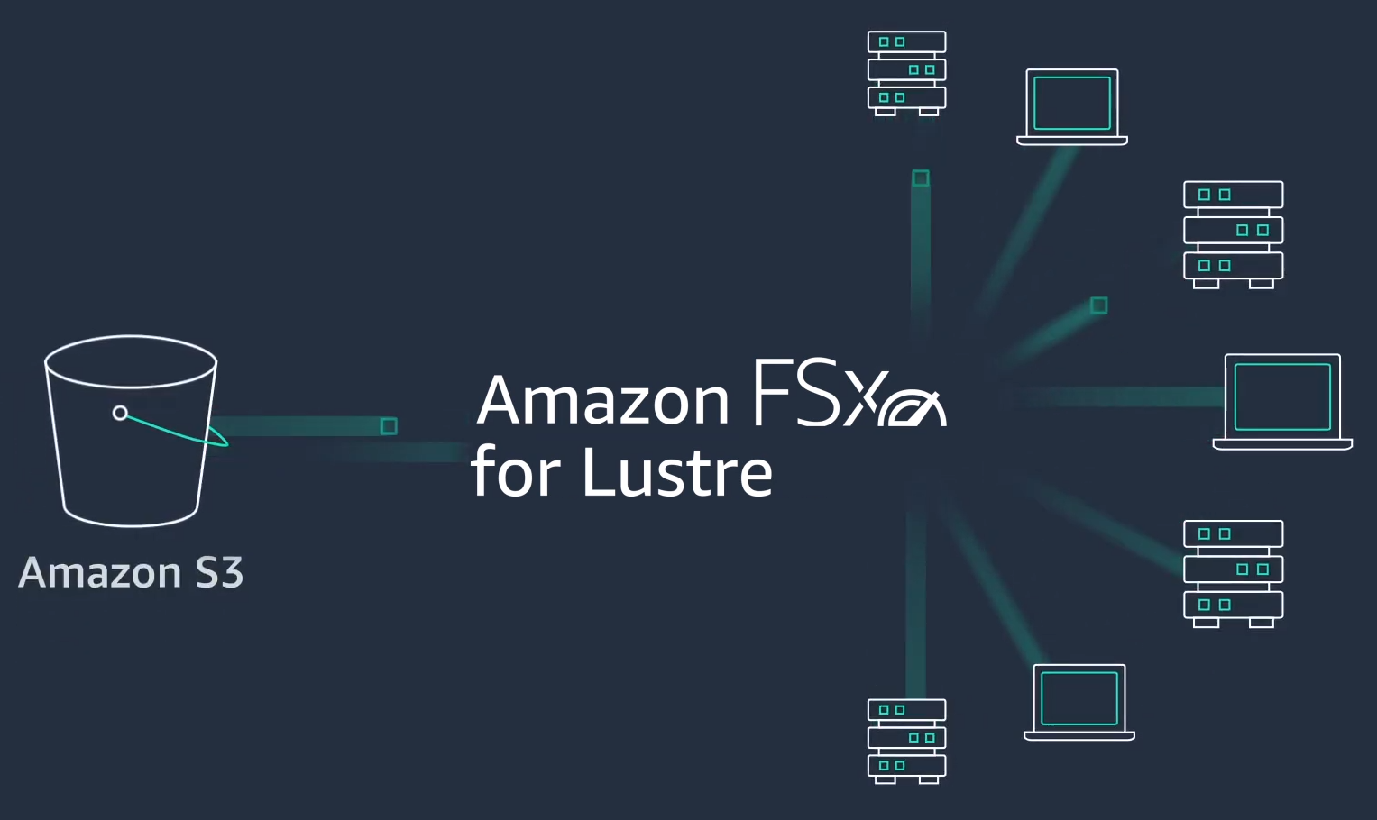
Amazon FSx for Lustre
We can integrate it with S3 that makes it easier to process datasets. When linked with S3, Lustre shows all S3 objects as files, and any change made will reflect in the S3 bucket as well

Slide 18


Amazon FSx for Lustre
Use Cases
Machine Learning
Media Processing and Transcoding
ML workloads use massive amounts of training data. Multiple instances need to process this training data simultaneously, so a shared file storage is very helpful
Media workflows, such as video rendering and visual effects, need compute and storage resources to handle the massive amounts of data being created

Slide 19
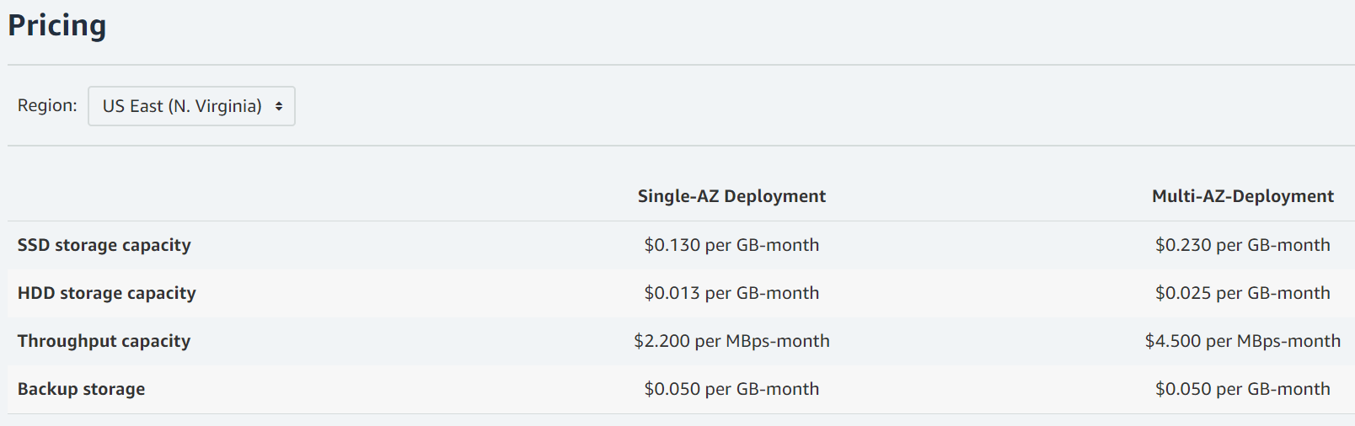
Amazon FSx Pricing
For Windows File Server
For Lustre

Slide 20
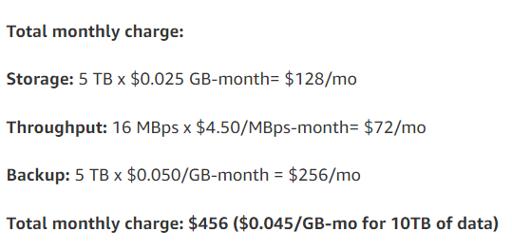
Amazon FSx Pricing
Pricing Example
Assume, we want to store 10 TB of general-purpose file share data using HDD storage in the US East (N. Virginia) region. Based on the typical deduplication savings of 50–60%, we provision a 5 TB multi-AZ file system with 16 MBps of throughput capacity. Also, assume that we have an average backup storage of 5 TB during the month
For Windows File Server
For Lustre

Slide 21
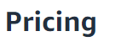
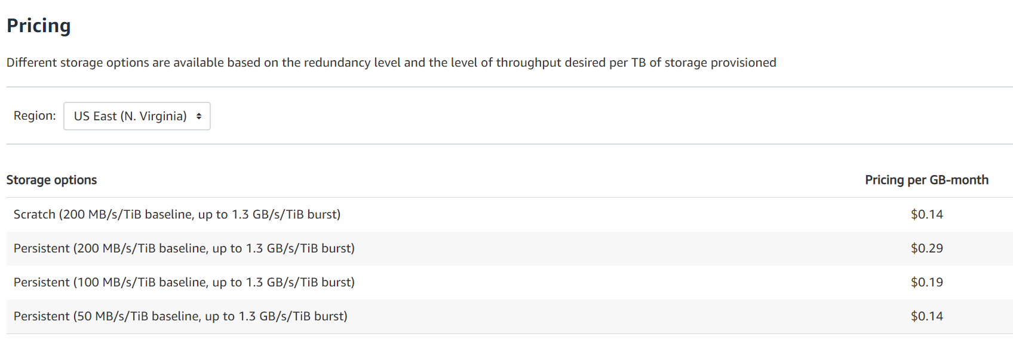
Amazon FSx Pricing
For Windows File Server
For Lustre

Slide 22
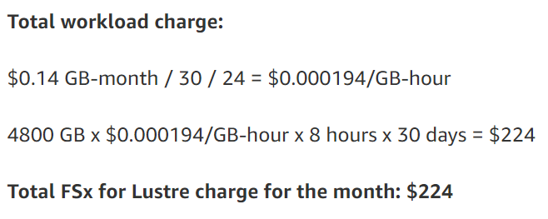
Amazon FSx Pricing
Pricing Example
Assume, we have a scratch file system in the US East (N. Virginia) region, which has been provisioned with 4,800 GB of storage capacity, and we spin up our file system for an 8-hour workload every day and then shut it down. We do this for 30 days (a month)
For Windows File Server
For Lustre

Slide 23
Hands-on: Amazon FSx for Windows File Server

Slide 24
Hands-on: Amazon FSx for Lustre

Slide 25
Introduction to Global Accelerator

Slide 26
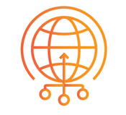
Introduction to Global Accelerator
AWS Global Accelerator is a service that improves the availability and performance of our applications with local or global users
It provides static IP addresses that will act as a fixed entry point to our application endpoints on EC2, Beanstalk, or load balancers

Slide 27
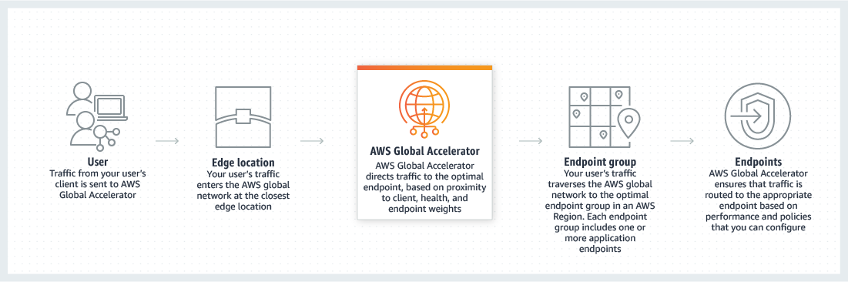
Introduction to Global Accelerator
How does Global Accelerator work?
Edge Location
AWS Global Accelerator
Endpoint Group
Endpoints
User
AWS Global Accelerator directs traffic to the optimal endpoint based on proximity to the client, health, and endpoint weights
Traffic from our user’s client is sent to AWS Global Accelerator
Our user’s traffic enters the AWS global network at the closest edge location
Our user’s traffic traverses the AWS global network to the optimal endpoint group in an AWS region. Each endpoint group includes one or more application endpoints
AWS Global Accelerator ensures that the traffic is routed to the appropriate endpoint based on performance and policies that we can configure

Slide 28
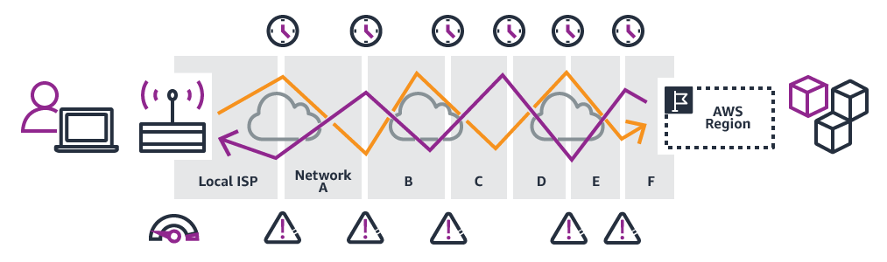
Introduction to Global Accelerator
Without Global Accelerator
It can take many networks to reach the application. Paths to and from the application may differ. Each hop impacts performance and can introduce risks

Slide 29
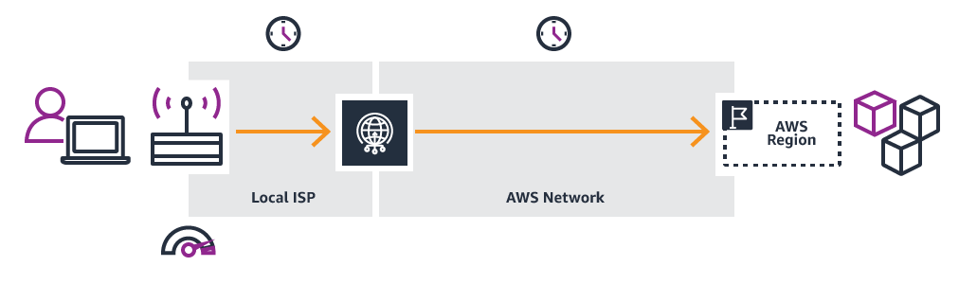
Introduction to Global Accelerator
With Global Accelerator
Adding AWS Global Accelerator removes these inefficiencies. It leverages the AWS global network, resulting in improved performance

Slide 30
Introduction to Global Accelerator
Benefits of Using Global Accelerator
Instant regional failover
High availability
No variability around clients that cache IP addresses
Improved performance
Easy manageability
Fine-grained control

Slide 31

Introduction to Global Accelerator
There is BYOIP (Bring Your Own IP address) facility in Global Accelerator. This lets us use our own IP address as the entry point static IP
How does this help?
This allows us to move our on-premises applications that have hardcoded IP address dependencies to AWS, without making any client-facing changes

Slide 32


Introduction to Global Accelerator
Use Cases
Scales for Increased Application Utilization
Protects the Applications
When app usage grows, the number of IPs to manage also increases. Global Accelerator takes care of scaling our network up or down
While making our ELB or EC2 instances Internet-facing, the exposure to attacks increases. Using GA, we can use an internal ALB or a private instance as an endpoint

Slide 33
Global Accelerator Components

Slide 34


Global Accelerator Components
Static IP Addresses
Accelerator
Global Accelerator provides two static IP addresses as endpoints or we can use a BYOIP address
It directs traffic to healthy endpoints over the AWS global network to increase availability and performance

Slide 35


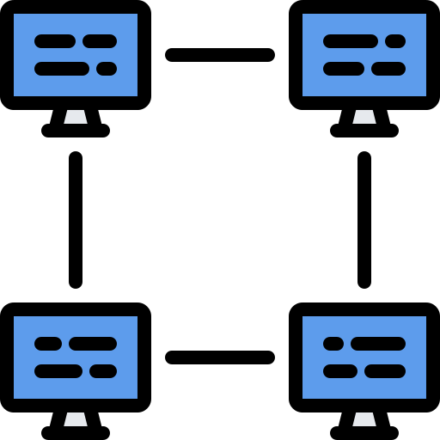
Global Accelerator Components
Network Zone
Listener
A network zone is an isolated unit with its own set of physical infrastructure, so if an IP becomes unavailable, we can try another IP in another network zone
Processes inbound connections from clients to Global Accelerator, based on the port (or port range) and the protocol (TCP and UDP) that we configure
Port 80

Slide 36

Global Accelerator Components
Endpoint Groups
Endpoints
Every endpoint group is associated with a region. There will be one or more endpoint groups in a region
Endpoints can be NLB, ALB, EC2 instances, or Elastic IP addresses. Traffic is routed to the endpoint according to the configuration we provide
us-east-1
eu-west-1
eu-east-2
Endpoint Group

Slide 37
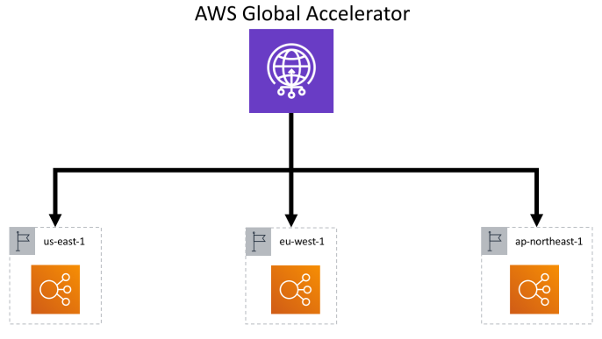
Global Accelerator Components
Let’s take an example. Here, we are connecting three load balancers, which are in three different locations with common endpoints

Slide 38
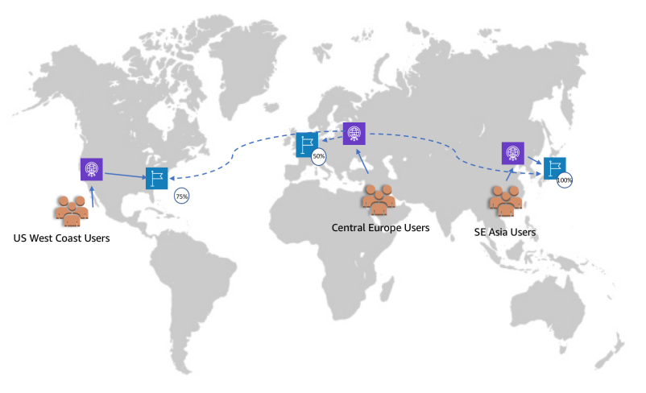
Global Accelerator Components

Slide 39

Global Accelerator: Quotas and Pricing
Quotas
Pricing
Accelerators for each AWS account: 20
Listeners for each Accelerator: 10
Port ranges for each listener: 10
Endpoints for each endpoint group: 10
Tags for each Accelerator: 50
Global Accelerator is not available in the free tier
There is a fixed fee for a full or partial hour usage of GA with a charge of $0.025 until it is detected

Slide 40
Introduction to AWS Organizations

Slide 41

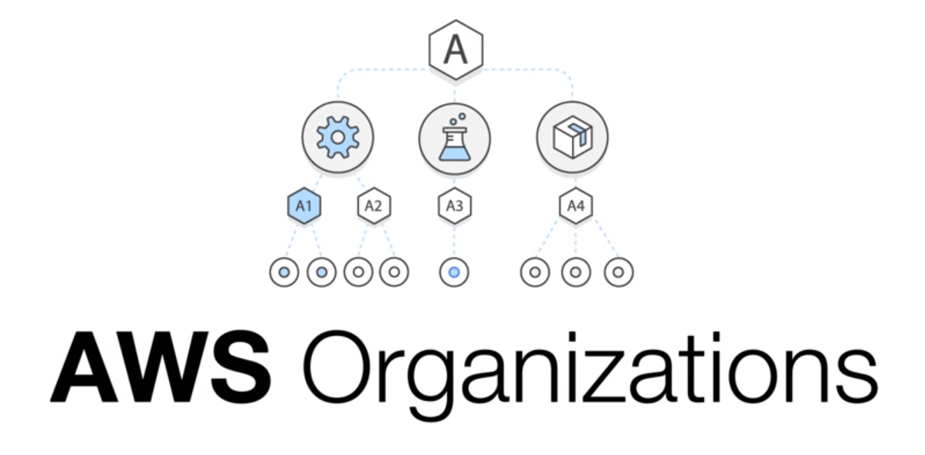
Introduction to AWS Organizations
AWS Organization is a tool that lets us centrally manage multiple AWS accounts added to our ‘organization’
If we are the administrator of an organization, then we can invite the existing AWS accounts to join Organizations or we can create accounts in Organizations directly

Slide 42
Introduction to AWS Organizations
AWS Organizations Features
Centralized management
Consolidated billing for all
member accounts
Control over the accounts’ usage
of services or APIs
Integration with AWS IAM
Consistent data replication,
eventually
Standardized tags across
accounts

Slide 43

Introduction to AWS Organizations
Pricing of AWS Organizations
There are no additional charges for AWS Organizations!
The charges apply to only the usage of other AWS resources by all member accounts

Slide 44

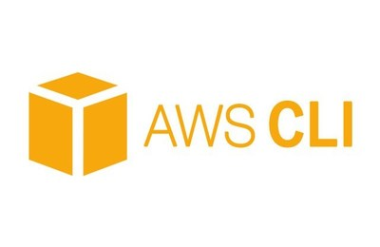
Introduction to AWS Organizations
Ways to Access AWS Organizations
AWS Management Console
AWS Command-line Tools
Organizations can be accessed through the browser-based AWS Management Console to manage resources
With AWS CLI, we can use the system’s command line to access Organizations using commands. It is faster than console

Slide 45
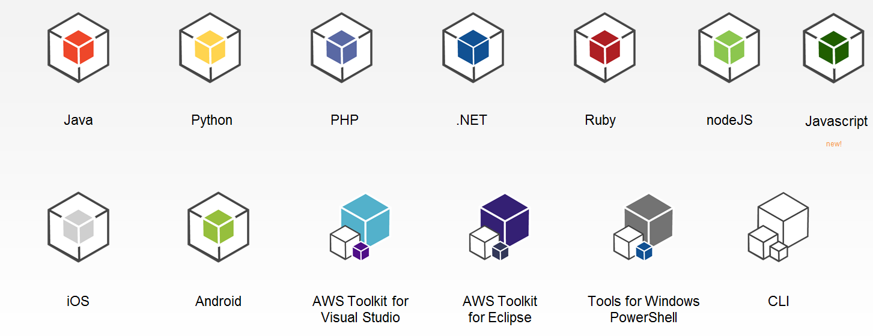

Introduction to AWS Organizations
Ways to Access AWS Organizations
AWS SDKs
HTTPS Query API
SDKs have libraries that can be used to write code as well as access AWS Organizations
It gives programmatic access to AWS Organizations and its services. We can issue HTTPs requests directly to a service

Slide 46
Introduction to AWS Organizations
AWS Organizations Quotas
Max. and Min. Values
Expiration Time for Handshakes
Number of roots in an Organization: 1
Number of OUs in an Organization: 1,000
Number of policies in an Organization: 1,000
OU maximum nesting in a root: 5
Number of member accounts that can be can created concurrently: 5
Invitation to join an Organization: 15 days
Request to enable all features in an Organization: 90 days
Handshake is deleted and no longer appears in lists: 30 days

Slide 47
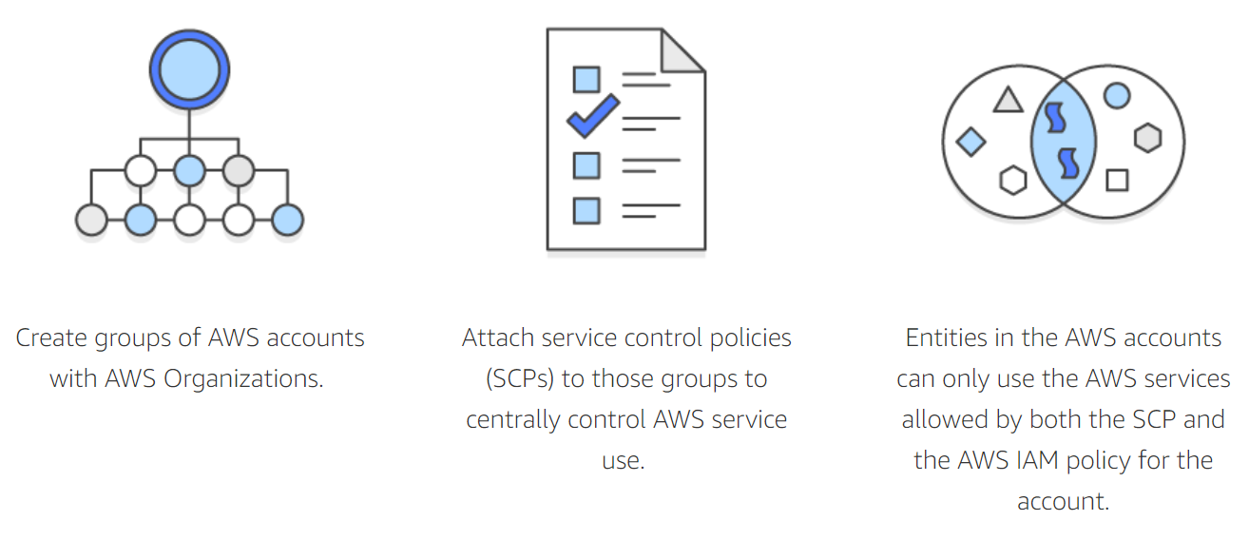
Introduction to AWS Organizations
How does AWS IAM work with Organizations?
Creates groups of AWS accounts with AWS Organizations
Attaches service control policies (SCPs) to those groups to centrally control AWS service use
Entities in AWS accounts can only use the AWS services allowed by both SCP and AWS IAM policies for each account

Slide 48
AWS Organizations Concepts

Slide 49

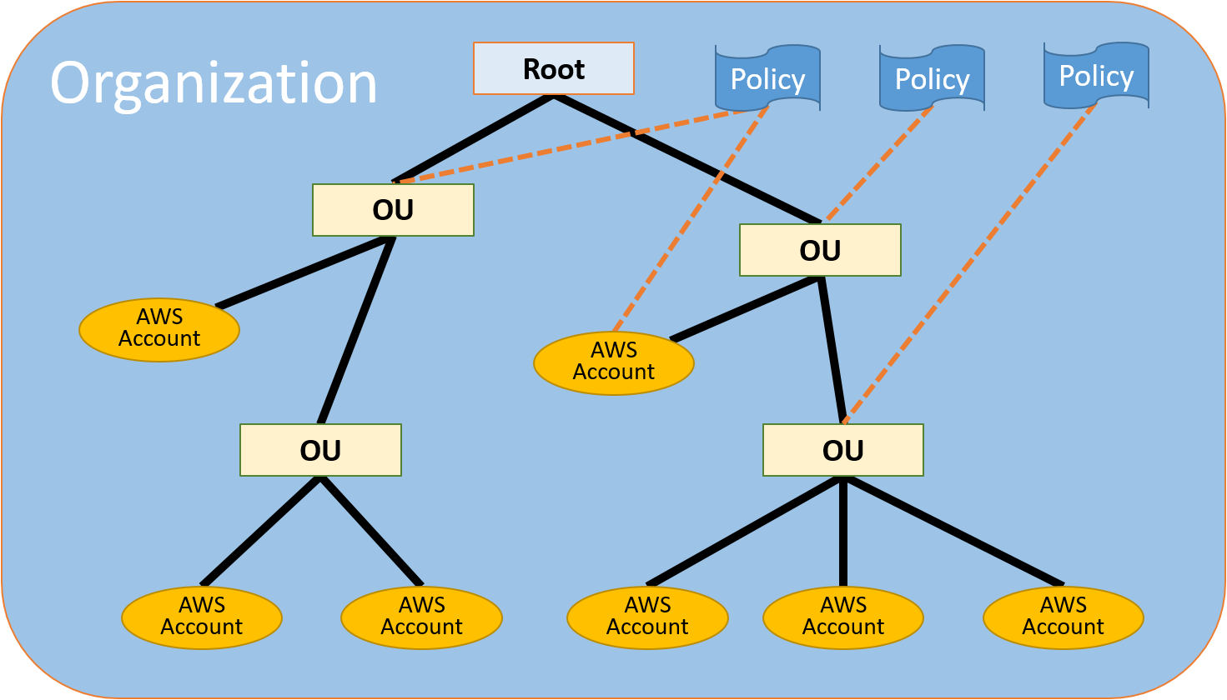
AWS Organizations Concepts
An example organization with multiple accounts

Slide 50

AWS Organizations Concepts
Organization
Organizations can be used to consolidate multiple AWS accounts so that we can administer them all as a single unit
Root
Organization Unit (OU)
Account
Invitation
An organization will have one master account and zero or more member accounts. We can organize our organization in an hierarchical order with a root on the top
Handshake

Slide 51
AWS Organizations Concepts
Organization
This is the master account for all subaccounts. It we apply a policy to root, it will be applied to all the member accounts and organization units
Root
Organization Unit (OU)
Root
Account
Invitation
We can have only one root and that will be automatically created when we create an organization
Handshake

Slide 52


AWS Organizations Concepts
Organization
A container for accounts within a root. An OU can contain other OUs and this is what enables the tree-like hierarchy that ends in accounts
Root
Organization Unit (OU)
Account
Organization Unit (OU)
Invitation
If we attach a policy to an OU, this affects all the other OUs under it, as well as to the member accounts
Handshake

Slide 53
AWS Organizations Concepts
Organization
An account is basically an AWS account that contains AWS resources. We can apply policies to the account only to control that account’s resources
Root
Organization Unit (OU)
Account
Master Account
Member Account
Invitation
This account creates the organization and we can administer using it
All other accounts in member accounts. They can be part of only one organization
Handshake

Slide 54

AWS Organizations Concepts
Organization
This is the process of asking another AWS account to join our organization. Only a master account can send out an invite. If they accept, they become a member
Root
Organization Unit (OU)
Account
Invitation
Handshake

Slide 55

AWS Organizations Concepts
Organization
Handshake is a multi-step process of sharing information between two accounts/parties. Handshakes are used to send out invitations and get back acknowledgement
Root
Organization Unit (OU)
Account
Invitation
We can work with handshakes directly if we are working with the organization’s API or AWS CLI tools
Handshake

Slide 56
Starting with Organizations

Slide 57
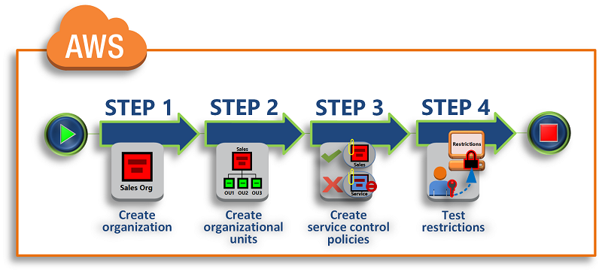
Starting with Organizations
Creating and Configuring an Organization
Create
an Organization
Create Organizational Units
Create
Service Control Policies
Test
Restrictions

Slide 58
Starting with Organizations
Step 1: Create an Organization
Open the AWS Management Console, and then choose our account name from the navigation bar
Choose My Organization
Choose Create Organization
Choose Enable all features or Enable only consolidated billing
Choose Create

Slide 59
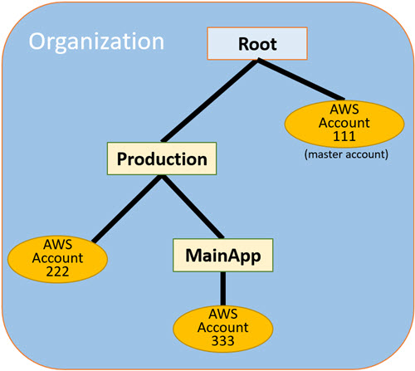
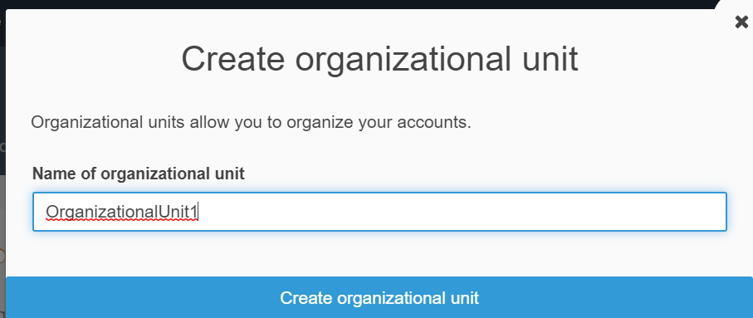
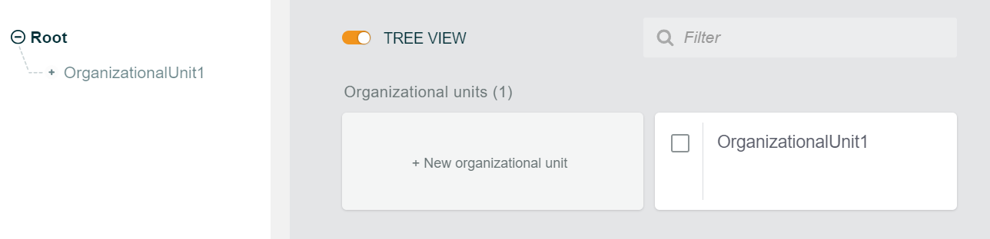
Starting with Organizations
Step 2: Create Organizational Units

Slide 60
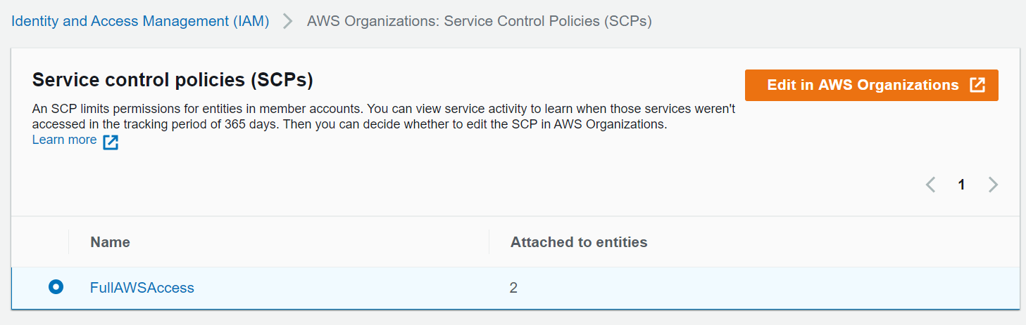
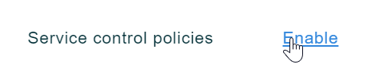
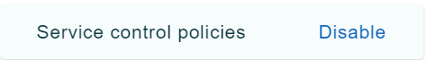
Starting with Organizations
Step 3: Create Service Control Policies
First, enable SCP
Then, check out the SCPs in the IAM console

Slide 61
Starting with Organizations
Step 4: Test Restrictions
AWS Organizations denies any attempt to perform an action in any service that isn't in the allow list
AWS Organizations denies any attempt to perform an action that isn't in the allow list policy and any action that is in the deny list policy
Test the master account to check if any of these rules affect the root account; they shouldn’t affect the root account

Slide 62
Elastic Network Interface

Slide 63

Elastic Network Interface
Elastic Network Interface
An elastic network interface (ENI) is a logical networking component in a VPC that represents a virtual network card. When we move a network interface from one instance to another, network traffic is redirected to the new instance

Slide 64
Elastic Network Interface
IP Addresses per Network Interface per Instance Type
Instance Type | Maximum NIs | Private IPv4 Addresses per Interface | IPv6 Addresses per Interface
a1.xlarge | 4 | 15 | 15
c1.medium | 2 | 6 | IPv6 not supported
t2.micro | 2 | 2 | 2
t2.small | 3 | 4 | 4
t2.medium | 3 | 6 | 6
z1d.metal | 15 | 50 | 50

Slide 65
Elastic Network Interface
When do we need a network interface?
We will have to attach multiple network interfaces in the following scenarios:
Creating a management network
Using network and security appliances in our VPC
Creating dual-homed instances with workloads/roles on distinct subnets
Creating a low-budget, high-availability solution

Slide 66
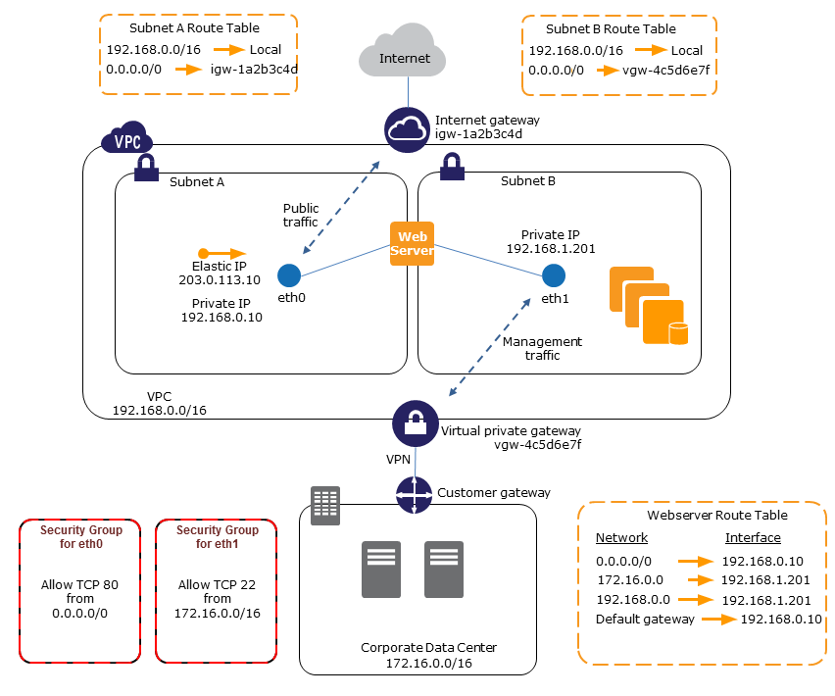
Elastic Network Interface
Scenario Example
We can create a management network using network interfaces. In this scenario, the primary network interface (eth0) on the instance handles public traffic, and the secondary network interface (eth1) handles backend management traffic and is connected to a separate subnet in our VPC that has more restrictive access controls

Slide 67
Elastic Network Adapter

Slide 68

Elastic Network Adapter
Elastic Network Adapter
Amazon EC2 provides enhanced networking capabilities through the elastic network adapter (ENA). It supports network speeds up to 100 GBps for the supported instance types

Slide 69
Elastic Network Adapter
All the available instance types
All the available AMIs
A1, C5, C5d, C5n, F1, G3, G4, H1, I3, I3en, Inf1, m4.16xlarge, M5, M5a, M5ad, M5d, M5dn, M5n, P2, P3, R4, R5, R5a, R5ad, R5d, R5dn, R5n, T3, T3a, u-6tb1.metal, u-9tb1.metal, u-12tb1.metal, u-18tb1.metal, u-24tb1.metal, X1, X1e, and z1d instances
Amazon Linux 2
Amazon Linux AMI 2018.03
Ubuntu 14.04 (with linux-aws kernel) or later
Red Hat Enterprise Linux 7.4 or later
SUSE Linux Enterprise Server 12 SP2 or later
CentOS 7.4.1708 or later
FreeBSD 11.1 or later
Debian GNU/Linux 9 or later

Slide 70
Elastic Fabric Adapter

Slide 71
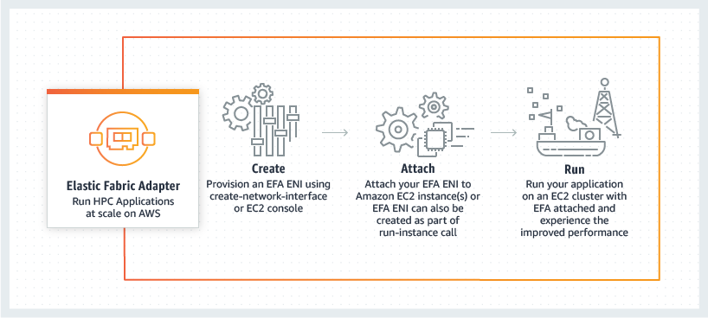
Elastic Fabric Adapter
Elastic Fabric Adapter
The network device that we can attach to our Amazon EC2 instance to accelerate High Performance Computing (HPC) and Machine Learning applications
Create
Provision an EFA ENI using create-network-interface or
the EC2 console
Attach
Attach EFA ENI to Amazon EC2 instance(s) or EFA ENI can also be created as part of the run-instance call
Run
Run our application on an EC2 cluster with EFA attached and experience the improved performance
Elastic Fabric Adapter
Run HPC applications at scale
on AWS

Slide 72
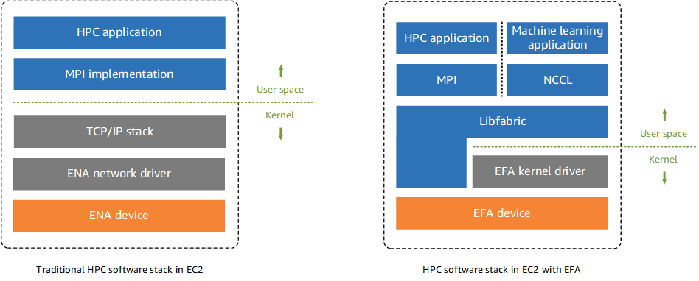
Elastic Fabric Adapter
To put it simply, an EFA is an ENA with added functionalities. It provides an additional OS-bypass function, which allows HPC and ML apps to directly communicate over a network interface to achieve low latency

Slide 73
Elastic Fabric Adapter
Difference Between EFAs and ENAs
ENAs provide traditional IP networking features that are required to support VPC networking
EFAs provide all of the same traditional IP networking features as ENAs, and they also support OS-bypass capabilities

Slide 74
Elastic Fabric Adapter
Supported Instance Types
Supported AMIs
c5n.18xlarge, c5n.metal, i3en.24xlarge, i3en.metal, inf1.24xlarge, m5dn.24xlarge, m5n.24xlarge, r5dn.24xlarge, r5n.24xlarge, and p3dn.24xlarge
Amazon Linux 2
Amazon Linux
RHEL 7.6
RHEL 7.7
CentOS 7
Ubuntu 16.04
Ubuntu 18.04

Slide 75
Elastic Fabric Adapter
What are the limitations of EFAs?
We can attach only one EFA per instance
We cannot send EFA traffic from one subnet to another subnet. Only the normal IP traffic can be sent. EFA OS-bypass traffic is limited to a single subnet
EFA OS-bypass traffic cannot be routed, only the IP traffic from EFA can be routed
A security group that allows inbound and outbound traffic to and from the security group itself should be attached to an EFA

Slide 76

India: +91-7847955955
US: 1-800-216-8930 (TOLL FREE)
support@intellipaat.com
24/7 Chat with Our Course Advisor
Notes:
Thank you!

